Slide 1
Employee Data Analysis using Excel
Name: G. Monika
Department: b.com accounting and finance
Reg no: 312200258
College: Sivet College
Nan mudhalvan I'd : asunm103unm103312200258

Slide 2
PROJECT TITLE
Employee
Performance
Analysis using
Excel

Slide 3


AGENDA
Problem Statement
Project Overview
End Users
Our Solution and Proposition
Dataset Description
Modelling Approach
Results and Discussion
Conclusion
3/21/2024 Annual Review

Slide 4

PROBLEM STATEMENT This analysis is created to track the performance of the employees, in order to provide promotions, incentives to the respective employees. This analysis helps the organisation to grow by the growth of the employees of the organisation.

Slide 5

PROJECT OVERVIEW
.
Employee Performance Analysis is created to analyse all the data like attendance, gender, age, high, medium, low, very high skilled employees of the organisation.

Slide 6

WHO ARE THE END USERS? Employees Managers Employers Managerial organisations Industrial organisations

Slide 7

OUR SOLUTION AND ITS VALUE PROPOSITION Conditional formatting - missing Pivot tables - summary Charts – trend Filtering and Formula - performance Graph – data visualization

Slide 8
Dataset Description Employee = Kaggle 26 – Features 9 - Features Employee id – numerical values Name – text Employee type Performance level Employee rating – numerical values

Slide 9

THE "WOW" IN OUR SOLUTION
Performance level =IFS(Z8>=5,”VERY HIGH”,Z8>=4,”HIGH”,Z8>=3,”MED”,TRUE,”LOW”)
3/21/2024 Annual Review
‹#›

Slide 10
MODELLING
Data collection
Downloaded from Edunet dashboard
Data cleaning
Identified the missing values
Filter out missing values
Performance level
Created a formula
Summary
Pivot table
Graph
‹#›

Slide 11
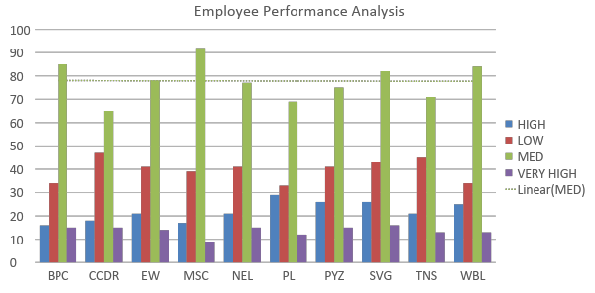
Results
‹#›

Slide 12
Conclusion While we comparing the performance of the employees, the number of employees are highly performed PL sector of the organization. We should motivate the employees of the other sectors by giving different kinds of tasks based on their strength, in order to improve the standard of the organization.

